Slide 2
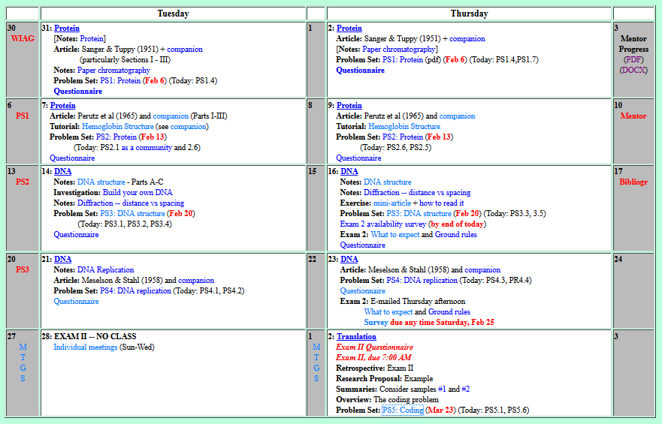
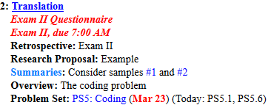
Welcome to Molecular Biology Through Discovery Thursday, 2 March 2017

Slide 3
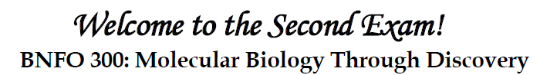
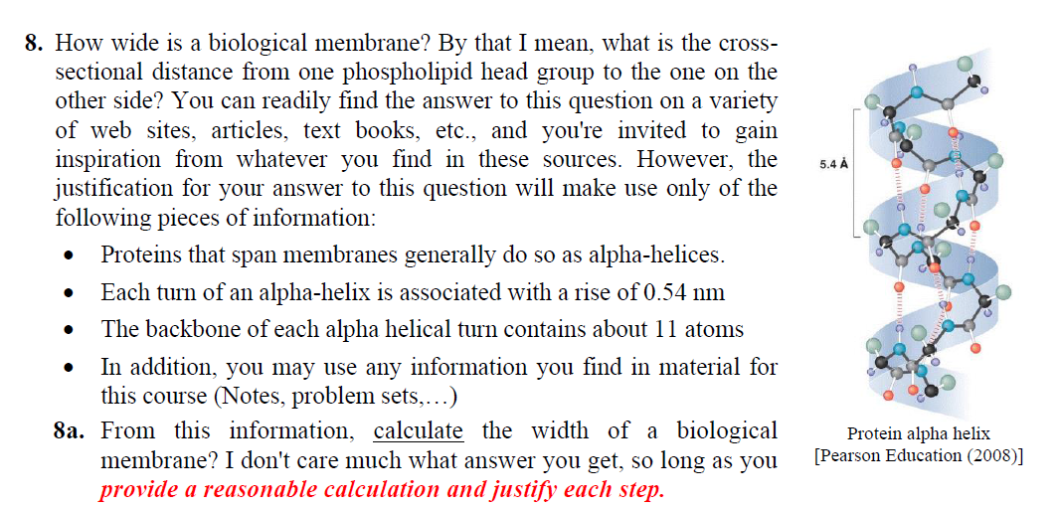

Slide 4
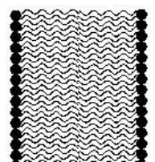
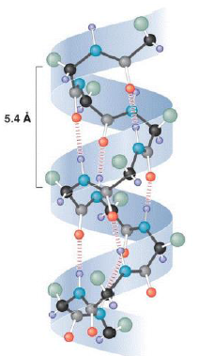
How wide is a membrane?
3 turns x 5.4 Å/turn?

Slide 5
How wide is a membrane?
5 turns x 5.4 Å/turn?

Slide 7
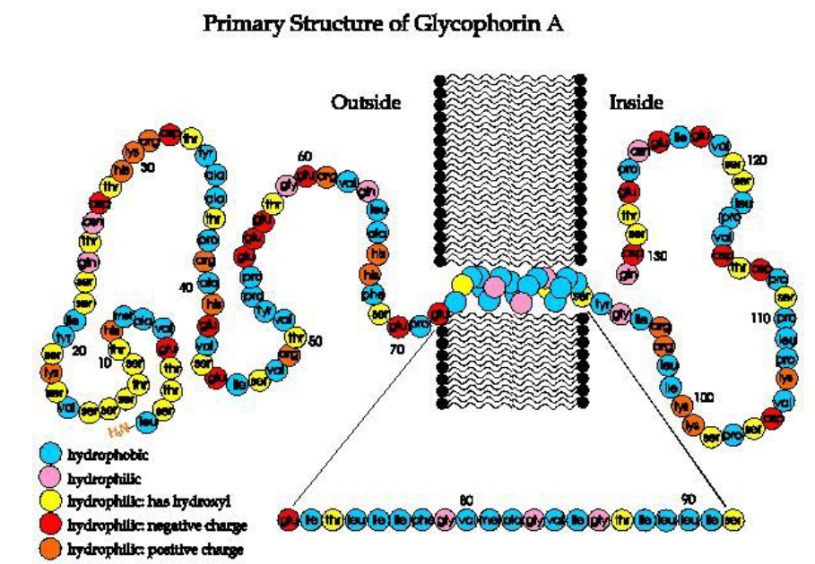
21aa

Slide 8
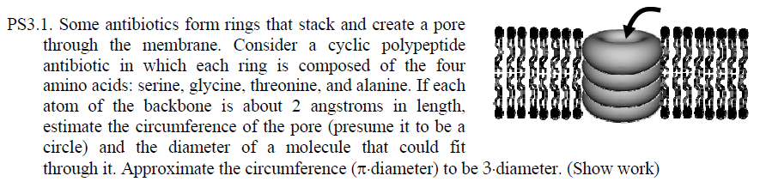
Length of amino acid?

Slide 9
21aa x 3 atoms/aa

Slide 10
How wide is a membrane?
(63 atoms)/(11 atoms/turn) x 5.4 Å/turn?

Slide 11
Welcome to Molecular Biology Through Discovery Thursday, 2 March 2017

Slide 13
Welcome to Molecular Biology Through Discovery Thursday, 2 March 2017

Slide 14
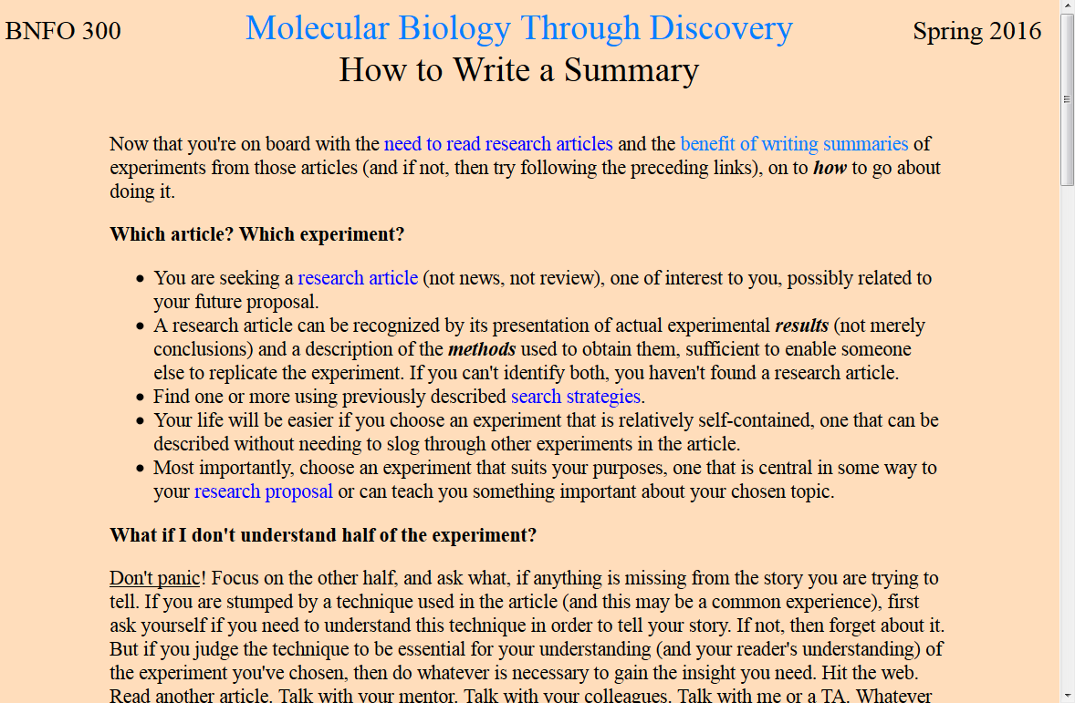

Slide 15
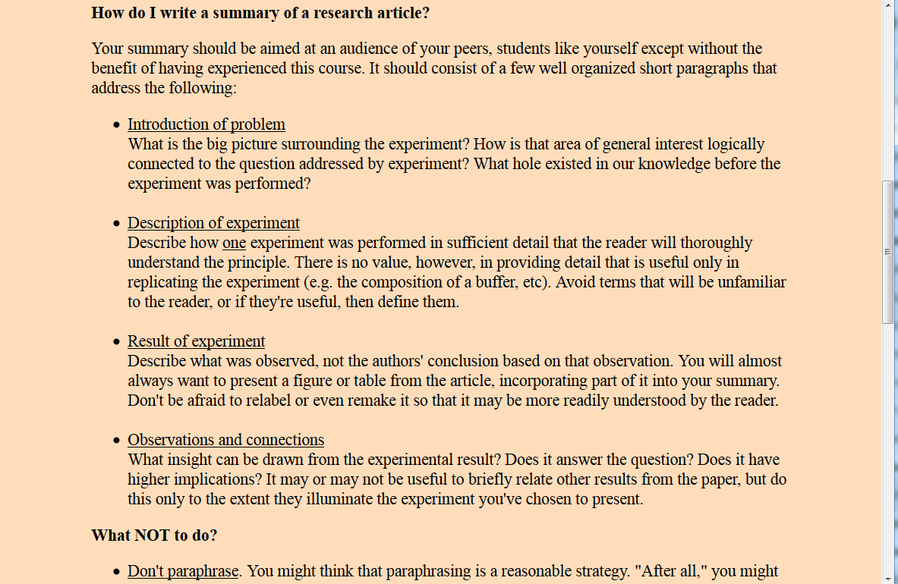

Slide 16
Welcome to Molecular Biology Through Discovery Thursday, 2 March 2017

Slide 17
Summary #1

Slide 18
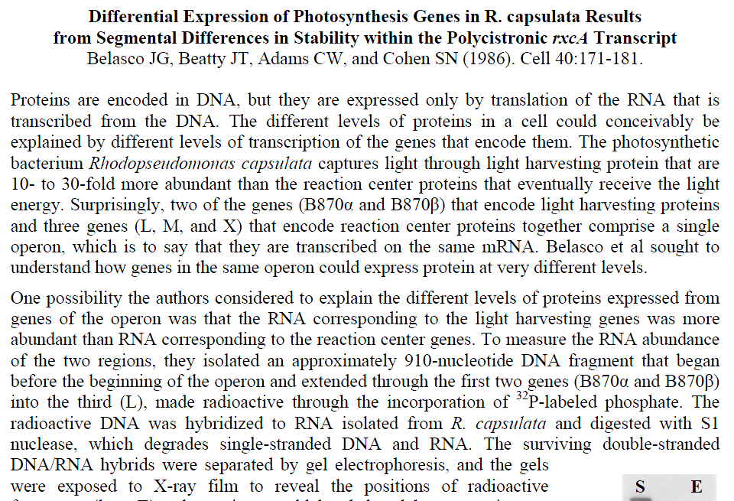
Summary #2

Slide 19
Welcome to Molecular Biology Through Discovery Thursday, 2 March 2017

Slide 20
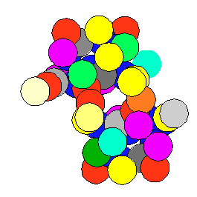
Central Dogma: DNA to RNA to Protein
Replication
DNA
Processing / Translocation

Slide 21
Central Dogma: DNA to RNA to Protein
Replication
DNA
Processing / Translocation

Slide 22
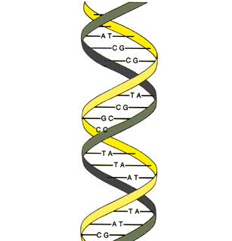


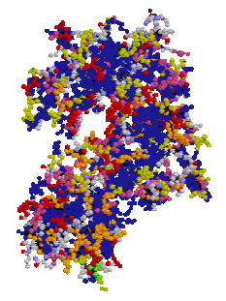
Information
Structure + Function
+ Self-assembly
C G A C C A T C G C C T T A G T A C
DNA
Protein

Slide 23
Length of nucleotide?
0.34 nm

Slide 24
Length of amino acid?

Slide 25
Length of amino acid?

Slide 26
Length of amino acid?
0.35 nm

Slide 27
Length of nucletotide:amino acid
0.35 nm
0.34 nm

Slide 28
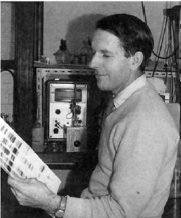
Information
Structure + Function
+ Self-assembly
C G A C C A T C G C C T T A G T A C
DNA
Protein

Slide 29
Information
Structure + Function
+ Self-assembly
{A - Alanine C - Cysteine D – Aspartate . . . Y – Tyrosine}
{A,C,G,T}
4 letters
20 letters
1 nucleotide → 1 amino acid?

Slide 30
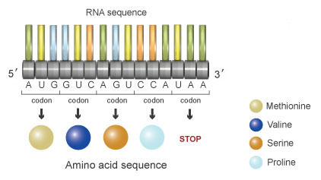
Types of Genetic Codes
Length – Duplet, Triplet, Variable,..
Degeneracy – Degenerate, non-degenerate
Overlap – (partially-, non-) overlapping

Slide 31
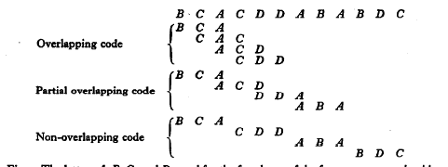
Types of Genetic Codes
Length – Duplet, Triplet, Variable,..
Degeneracy – Degenerate, non-degenerate
Overlap – (partially-, non-) overlapping
1 nucleotide → 1 amino acid?

Slide 32
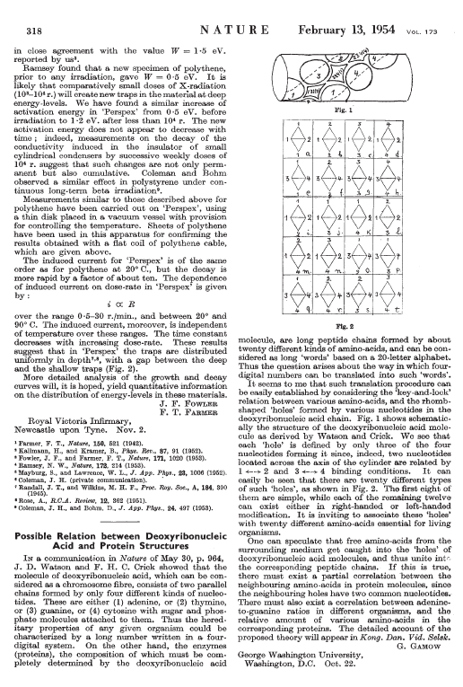
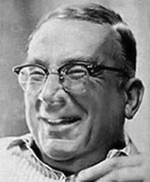
Proposed triplet overlapping code
George Gamow

Slide 33
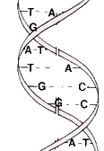
George Gamow

Slide 34
Welcome to Molecular Biology Through Discovery Thursday, 2 March 2017

Slide 35
Problem Set 5, #7

Slide 36
Problem Set 5, #7

Slide 37
Problem Set 5, #1

